Slide 1


Kafi Ramadhani Borut, S.Kom , M.Kom Co-Founder i-ot.net
Workshop Pemograman IoT Berbasis Arduino

Slide 2
Thanks To
Dekan Fakultas Ilmu Komputer
Wakil Dekan 1 Fakultas Ilmu Komputer
Wakil Dekan 1 Fakultas Ilmu Komputer
Wakil Dekan 3 Fakultas Ilmu Komputer, Founder i-ot.net, Mentor sekaligus Panutan Saya
Temen Temen Dosen Teknik Informatika Dan Sistem informasi
Segenap dan Seluruh Panitia Penyelenggara Workshop
Segenap dan Seluruh Peserta.

Slide 3
Biografi Penulis
Nama: Kafi Ramadhani Borut, S.Kom, M.kom
Pendidikan Terakhir : Magister Komputer, TF ITS Surabaya
Bidang Keahlian : Network, Security, Audit, dan Forensic
Email : admins@i-ot.net , dhaniborudxx@gmail.com
No. Hp / Wa : 0895328400080
Pekerjaan saat ini:
Researcher, Co-Founder I-ot.net, Founder Pasarmu.com
Hoby :
Ngotak Ngatik Server, Main Game, Ngotak Ngatik Server lagi
Visi Misi Terpenting :
BERMANFAAT Bagi Semua

Slide 4
IoT things?
What is ioT in Your Mind
Why IoT is needed for Now
Who Iot Target,
Where Iot Markets
When IoT is important Needed for All
And How Make it Easy, Ready and Reliable

Slide 5

i-ot.net Cloud I-ot System Hosted and Broker Server
Sekilas Info dan Iklan…
Have Vision and Mission 1. Routing All The World 2. Anything Devices Is Connected 3. Bring Reality (Rev Industry 4.0) 4. make it Easy For All Industry 4. I-ot Research Group
Why Us ??
Bring Solution For Your IoT Problem
Easy Config
Reliable
Secure
Low Price, High Standart
Trusted Human Resources
GOALLLL For Us
HAVE and Give BENEFIT FOR ALL

Slide 6
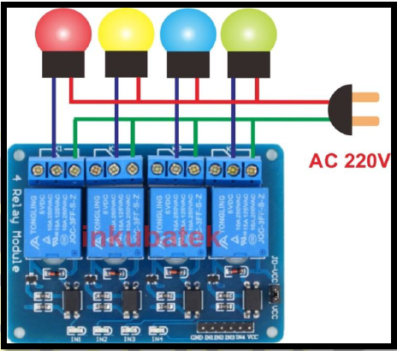
Smart Lamps
By: Tim i-ot.net

Slide 7
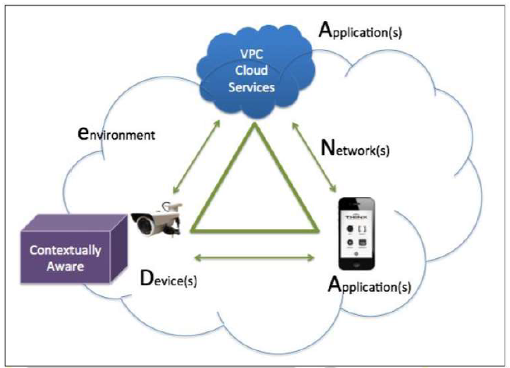
Sistem IoT

Slide 8
Yang dibutuhkan
Application
Silahkan diinstall IoT MQTT Panel dari PlayStore di HP Android
Cloud IoT
Digunakan broker i-ot.net sebagai Pengganti cloudmqtt.com
Device
Bisa digunakan IoT Starker Kit Produk Tokotronik atau Rakit Sendiri

Slide 9
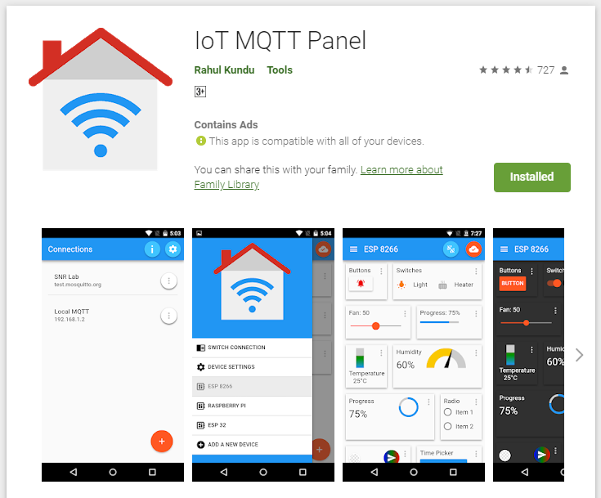
IoT MQTT Panel

Slide 10
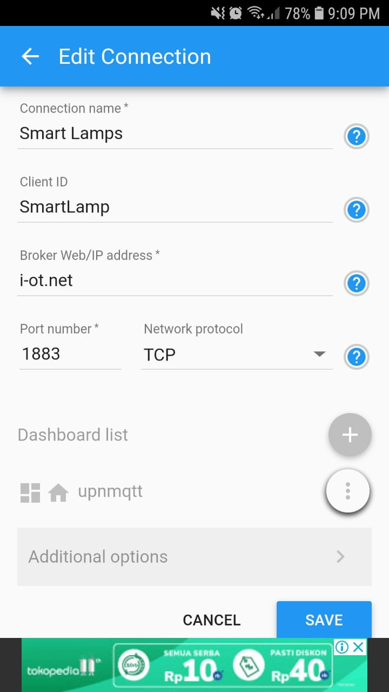
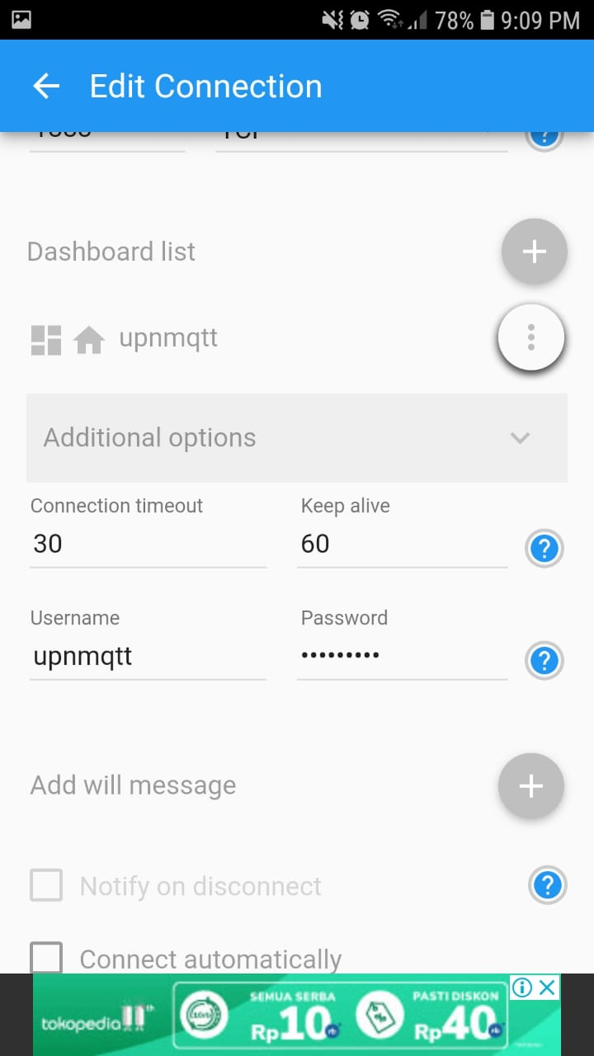
Seting Cloud IoT (i-ot.net) di IoT MQTT Panel
Isikan:
Connection name dll
User: upnmqtt
Password:
20upnmqtt

Slide 11
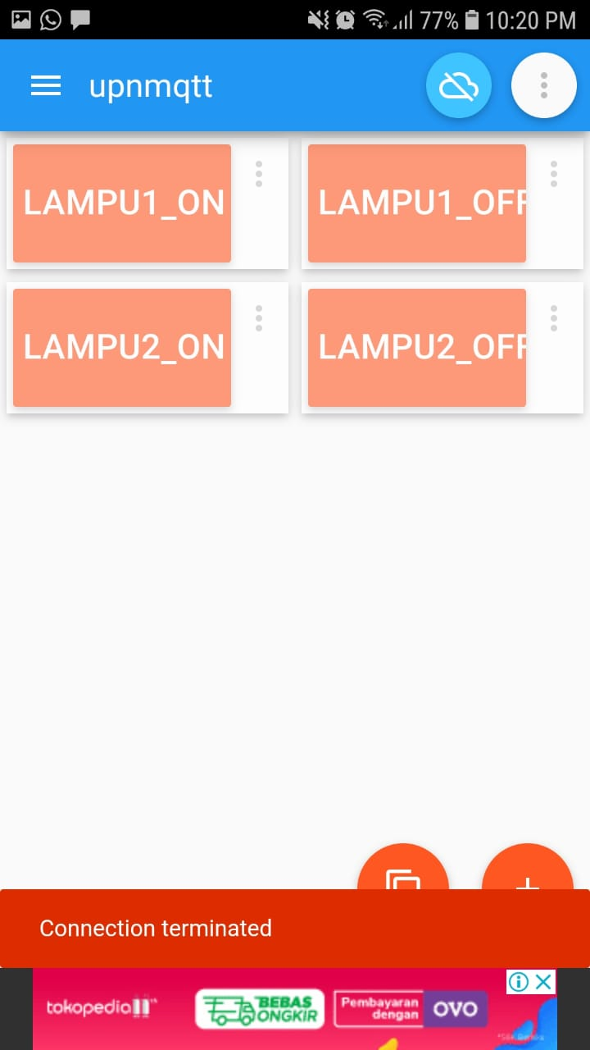
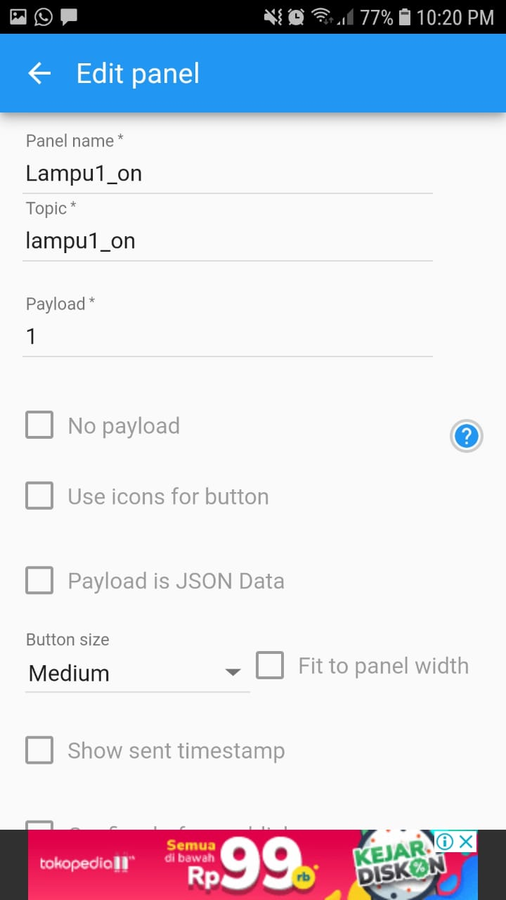
Buat Panel Kendali di IoT MQTT Panel
Yg penting:
Nama Topik harus sesuai dengan program di Mikrokontroller
Misal Panel 1, Topik diisi lampu1_on,
Lampu1_off dst
Payload diisi 1, 2, dst

Slide 12
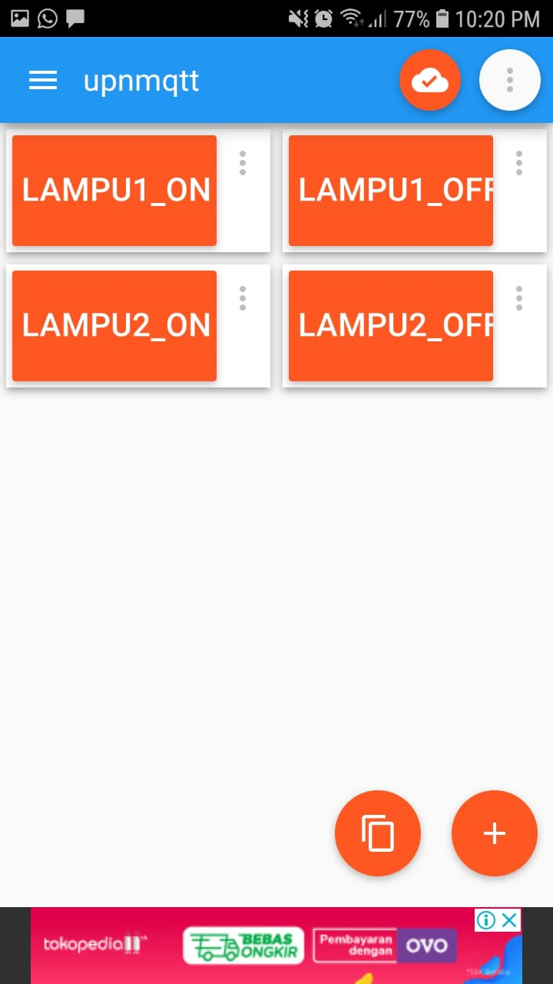
Tes Koneksi ke Cloud IoT (i-ot.net)
Buat dulu Panel seperti contoh
Coba tes koneksi
Warna akan berubah

Slide 13
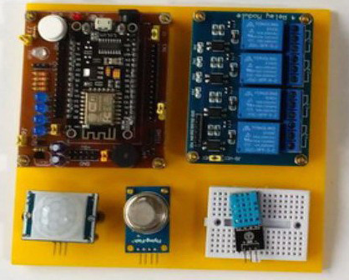
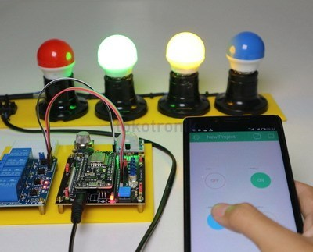
Device Bisa digunakan IoT Starker Kit Produk Tokotronik atau Rakit Sendiri

Slide 14
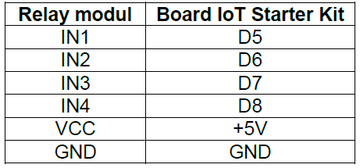
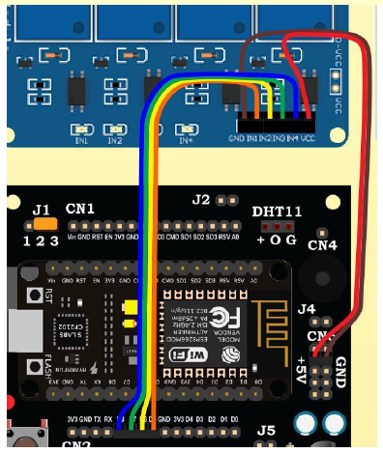
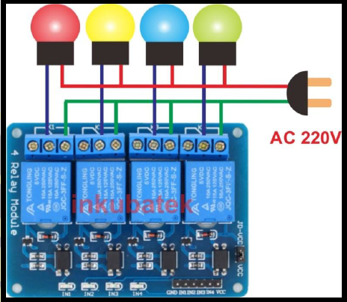
Device Koneksi Port

Slide 15
Pemrograman Arduino
/*************************************
* Program : SMART LAMPS
* Tim i-ot.net
* ***********************************/
#include <ESP8266WiFi.h>
#include <PubSubClient.h>
String Topic;
String Payload;
const char* ssid = “nama_wifi"; // Tergantung wifi yang digunakan
const char* password = “pass_wifi"; // Password wifi

Slide 16
#define IN_1 D5 // Lampu1
#define IN_2 D6 // Lampu2
#define IN_3 D7 // Lampu3
#define IN_4 D8 // Lampu4
#define mqttServer "i-ot.net"
#define mqttPort 1883
#define mqttUser "upnmqtt"
#define mqttPassword "20upnmqtt"
WiFiServer server(80);
WiFiClient espClient;
PubSubClient client(espClient);

Slide 17
void receivedCallback(char* topic, byte* payload, unsigned int length) {
Serial.print("Message received: ");
Serial.println(topic);
Serial.print("payload: ");
for (int i = 0; i < length; i++) {
Serial.print((char)payload[i]);
}
Serial.println();
/* we got '1' -> Lampu1_on */
if ((char)payload[0] == '1') {
digitalWrite(IN_1, HIGH);
}
/* we got '2' -> Lampu1_off */
if ((char)payload[0] == '2') {
digitalWrite(IN_1, LOW);
}

Slide 18
/* we got '3' -> Lampu2_on */
if ((char)payload[0] == '3') {
digitalWrite(IN_2, HIGH);
}
/* we got '4' -> Lampu2_off */
if ((char)payload[0] == '4') {
digitalWrite(IN_2, LOW);
}
}
void setup() {
Serial.begin(115200);
delay(10);
pinMode(IN_1, OUTPUT);
pinMode(IN_2, OUTPUT);
pinMode(IN_3, OUTPUT);
pinMode(IN_4, OUTPUT);
digitalWrite(IN_1, LOW);
digitalWrite(IN_2, LOW);
digitalWrite(IN_3, LOW);
digitalWrite(IN_4, LOW);

Slide 19
// Connect to WiFi network
Serial.println();
Serial.println();
Serial.print("Connecting to ");
Serial.println(ssid);
WiFi.begin(ssid, password);
while (WiFi.status() != WL_CONNECTED) {
delay(500);
Serial.print(".");
}
Serial.println("");
Serial.println("WiFi connected");
server.begin();
Serial.println("Server started");
Serial.print("Use this URL to connect: ");
Serial.print("http://");
Serial.print(WiFi.localIP());
Serial.println("/");

Slide 20
// Connect to Server IoT (CloudMQTT)
client.setServer(mqttServer, mqttPort);
client.setCallback(receivedCallback);
while (!client.connected()) {
Serial.println("Connecting to CLoudMQTT...");
if (client.connect("ESP32Client", mqttUser, mqttPassword )) {
Serial.println("connected");
} else {
Serial.print("failed with state ");
Serial.print(client.state());
delay(2000);
}
}
client.subscribe("lampu1_on");
client.subscribe("lampu1_off");
client.subscribe("lampu2_on");
client.subscribe("lampu2_off");
}

Slide 21
void loop() {
client.loop();
WiFiClient client = server.available();
if (!client) {
return;
}
Serial.println("new client");
while(!client.available()){
delay(1);
}
String request = client.readStringUntil('\r');
Serial.println(request);
client.flush();
if (request.indexOf("/IN_1on") > 0) {
digitalWrite(IN_1, HIGH);
}
if (request.indexOf("/IN_1off") >0) {
digitalWrite(IN_1, LOW);
}
if (request.indexOf("/IN_2on") > 0) {
digitalWrite(IN_2, HIGH);
}
if (request.indexOf("/IN_2off") >0) {
digitalWrite(IN_2, LOW);
}

Slide 22
// Return the response
client.println("HTTP/1.1 200 OK");
client.println("Content-Type: text/html");
client.println("");
client.println("<!DOCTYPE HTML>");
client.println("<html>");
client.println("<head>");
client.println("<meta name='apple-mobile-web-app-capable' content='yes' />");
client.println("<meta name='apple-mobile-web-app-status-bar-style' content='black-translucent' />");
client.println("</head>");
client.println("<body bgcolor = \"#f7e6ec\">");
client.println("<hr/><hr>");
client.println("<h4><center> Smart Lamps </center></h4>");
client.println("<hr/><hr>");
client.println("<br><br>");
client.println("<br><br>");
client.println("<center>");
client.println("ROBOT");
client.println("<a href=\"/IN_1on\"\"><button>Lampu1_On </button></a>");
client.println("<a href=\"/IN_1off\"\"><button>Lampu1_Off </button></a><br />");
client.println("</center>");
client.println("<br><br>");
client.println("<center>");
client.println("ROBOT");
client.println("<a href=\"/IN_2on\"\"><button>Lampu2_On </button></a>");
client.println("<a href=\"/IN_2off\"\"><button>Lampu2_Off </button></a><br />");
client.println("</center>");
client.println("<br><br>");
client.println("<center>");
client.println("<table border=\"5\">");
client.println("<tr>");
//=====================

Slide 23
client.println("<tr>");
client.println("</table>");
client.println("</center>");
client.println("</html>");
delay(1);
Serial.println("Client disonnected");
Serial.println("");
}

Slide 24
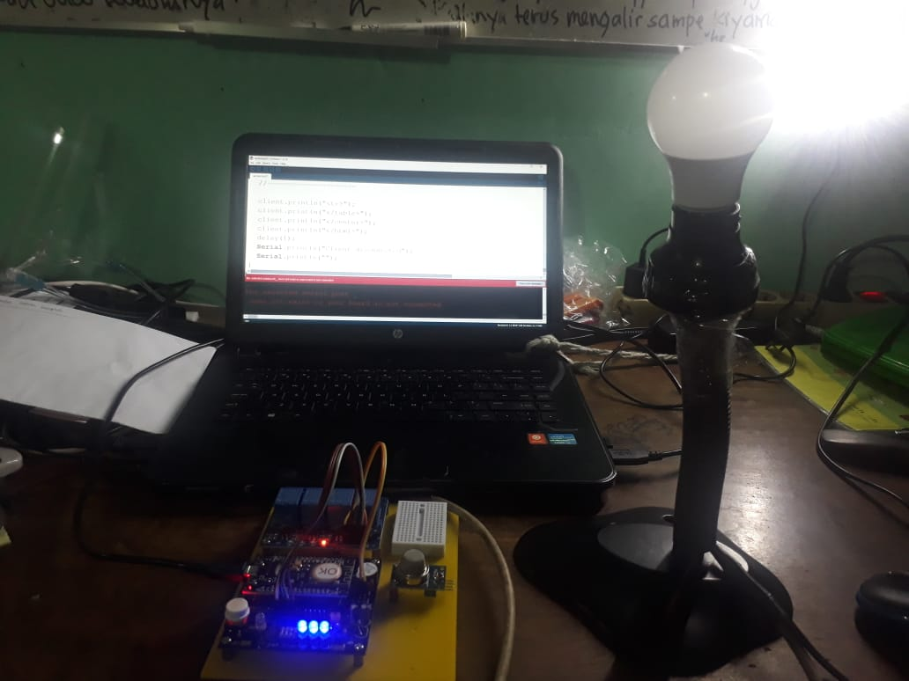
Gambaran Riset

Slide 25
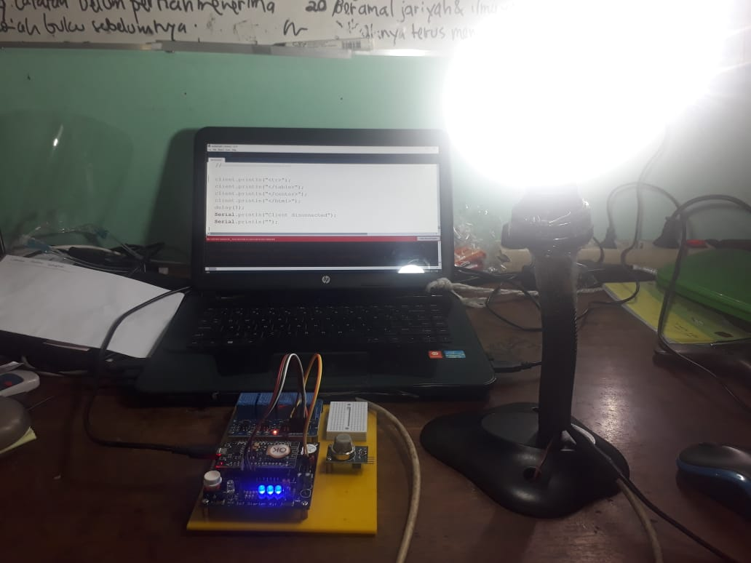
Gambaran Riset

Slide 26
Terimakasih…

